Slide 1
Internship 2022
Progress report on E-tricycle
Name: Brian Muindi

Slide 2
Internship 2022
Progress report on E-tricycle
Name: Brian Muindi

Slide 3
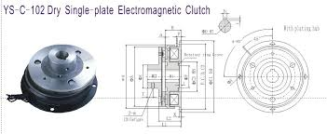
Tasks completed last week
[#Github issue 11]Mechanism for starting motor
Why select the electromagnetic clutch?
High precision torque control
Superior durability and long life
Stable slip torque

Slide 4
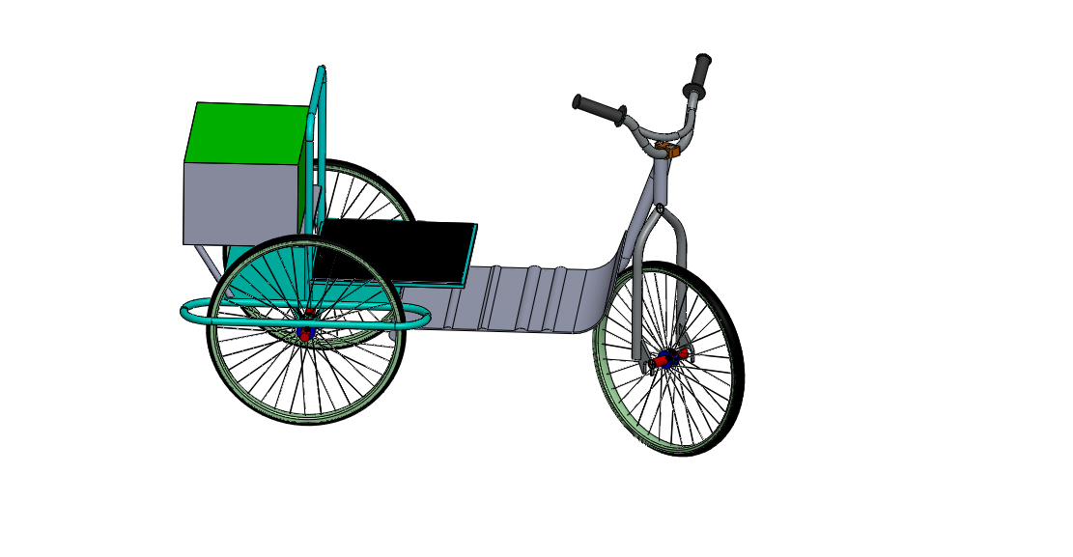
[#Github issue 19]3D modelling of the tricycle
Parts redesigned
Steering
Braking mechanism
Rear wheels
Motor positioning

Slide 5
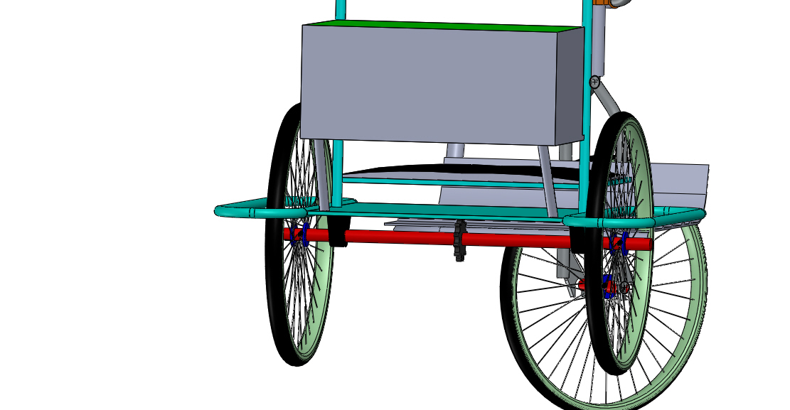
Tasks in this week
[#Github issue number 20] Shaft design

Slide 6
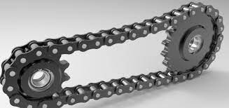
[#Github issue number 21] Design of chain drive
No of teeth on sprockets
Length of chain

Slide 7
Timeline
Month | Intern week | Tasks
Jan
 | Week 1 | Taking measurements and 3D modelling of the tricycle Mechanism for starting the motor Identification of parts
 | Week 2 | Design of chain drive Shaft design Acquisition of parts
 | Week 3
Feb | Week 4
 | Week 5
 | Week 6
 | Week 7

